Slide 1
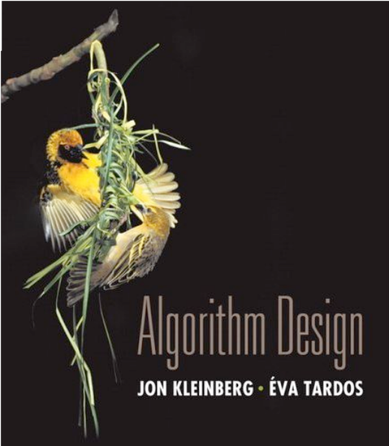

4. Greedy Algorithms I
coin changing
interval scheduling
scheduling to minimize lateness
optimal caching
Lecture slides by Kevin Wayne Copyright © 2005 Pearson-Addison Wesley
Copyright © 2013 Kevin Wayne
http://www.cs.princeton.edu/~wayne/kleinberg-tardos
Last updated on Sep 8, 2013 6:30 AM

Slide 2
4. Greedy Algorithms I
coin changing
interval scheduling
scheduling to minimize lateness
optimal caching

Slide 3


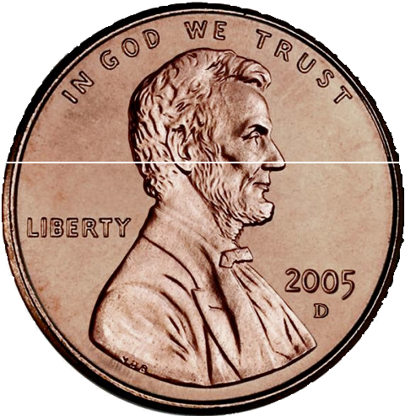
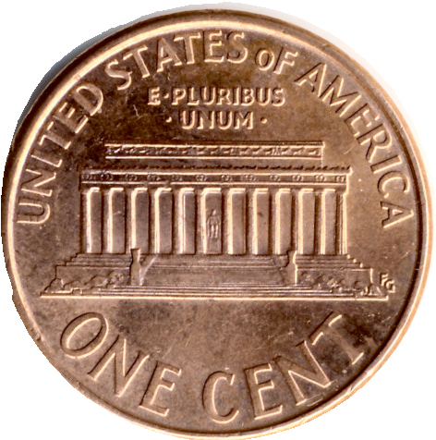
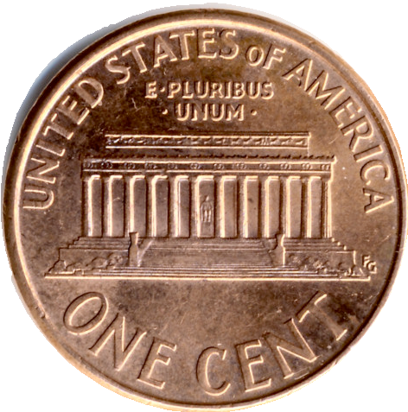
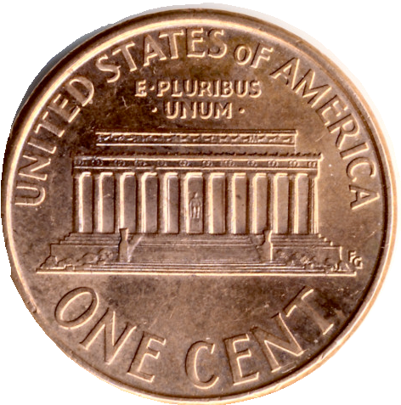
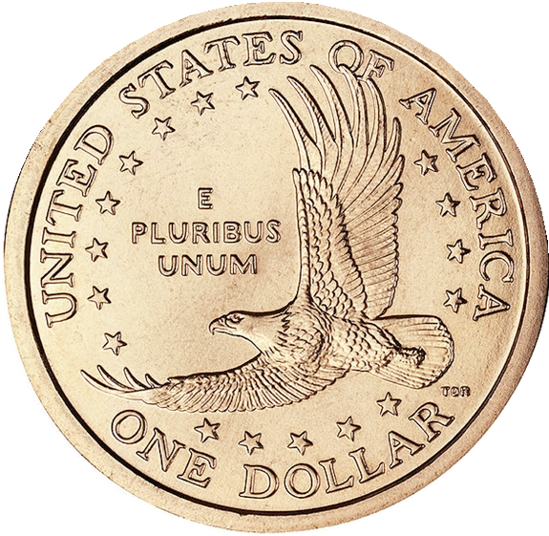



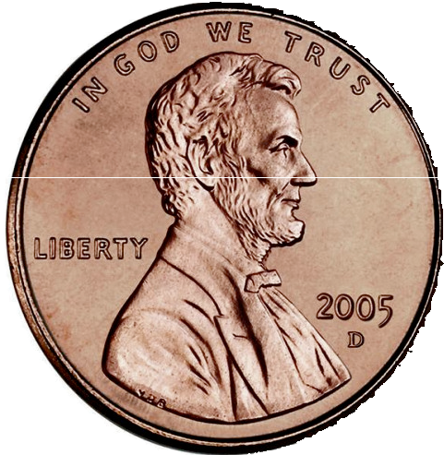
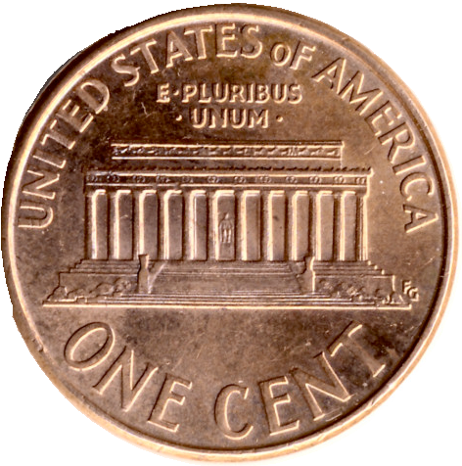


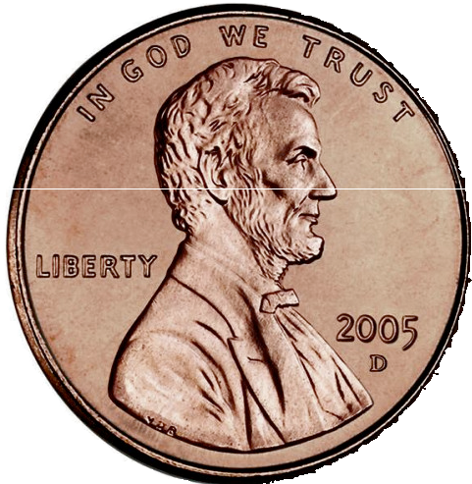
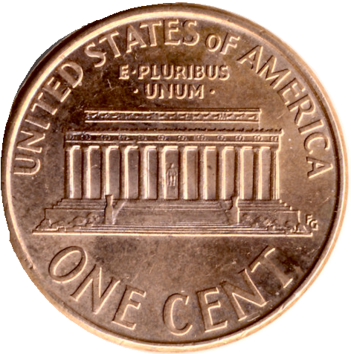
Coin changing
Goal. Given currency denominations: 1, 5, 10, 25, 100, devise a method to pay amount to customer using fewest number of coins.
Ex. 34¢.
Cashier's algorithm. At each iteration, add coin of the largest value that does not take us past the amount to be paid.
Ex. $2.89.

Slide 4
Cashier's algorithm
At each iteration, add coin of the largest value that does not take us past the amount to be paid.
CASHIERS-ALGORITHM (x, c1, c2, …, cn)
SORT n coin denominations so that c1 < c2 < … < cn
S ← φ
WHILE x > 0
k ← largest coin denomination ck such that ck ≤ x
IF no such k, RETURN "no solution"
ELSE
x ← x – ck S ← S ∪ { k }
RETURN S
set of coins selected
Q. Is cashier's algorithm optimal?

Slide 5

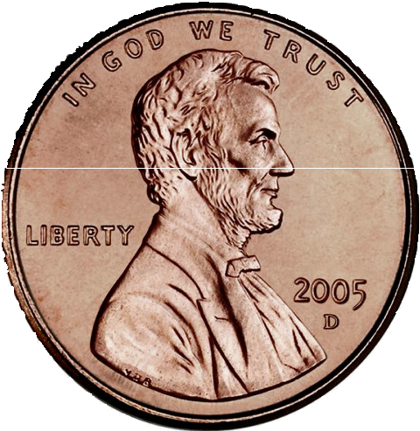








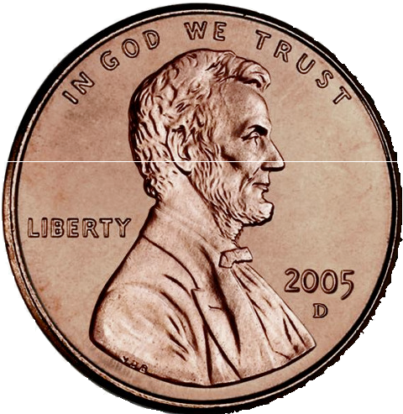
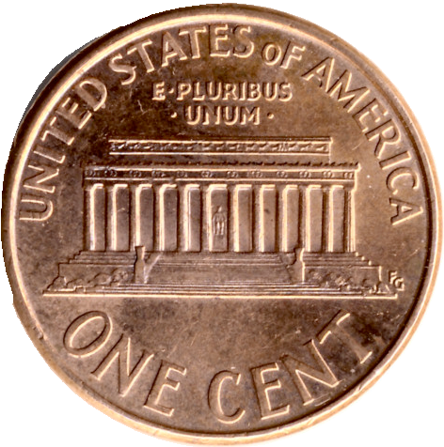
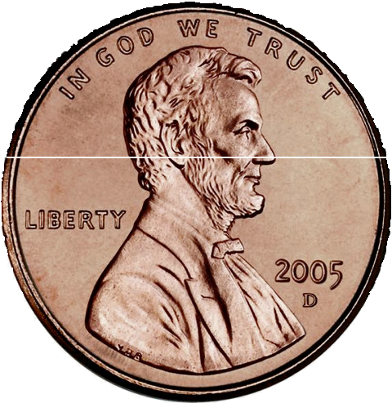
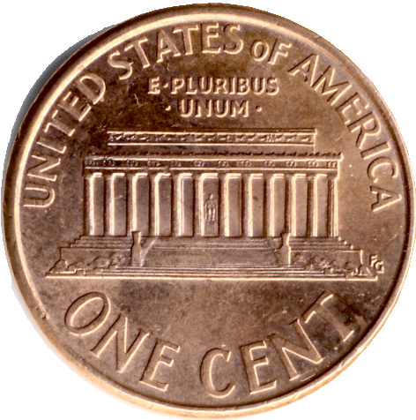
Properties of optimal solution
Property. Number of pennies ≤ 4. Pf. Replace 5 pennies with 1 nickel.
Property. Number of nickels ≤ 1. Property. Number of quarters ≤ 3.
Property. Number of nickels + number of dimes ≤ 2. Pf.
・Replace 3 dimes and 0 nickels with 1 quarter and 1 nickel;
・Replace 2 dimes and 1 nickel with 1 quarter.
・Recall: at most 1 nickel.

Slide 6
Analysis of cashier's algorithm
Theorem. Cashier's algorithm is optimal for U.S. coins: 1, 5, 10, 25, 100. Pf. [by induction on x]
・Consider optimal way to change c_{k} ≤ x < c_{k+1} : greedy takes coin k.
・We claim that any optimal solution must also take coin k.
- if not, it needs enough coins of type c₁, …, c_{k–1} to add up to x
- table below indicates no optimal solution can do this
・Problem reduces to coin-changing x – c_{k} cents, which, by induction, is optimally solved by cashier's algorithm. ▪
k | ck | all optimal solutions must satisfy | max value of coins c1, c2, …, ck–1 in any OPT
1 | 1 | P ≤ 4 | –
2 | 5 | N ≤ 1 | 4
3 | 10 | N + D ≤ 2 | 4 + 5 = 9
4 | 25 | Q ≤ 3 | 20 + 4 = 24
5 | 100 | no limit | 75 + 24 = 99

Slide 7

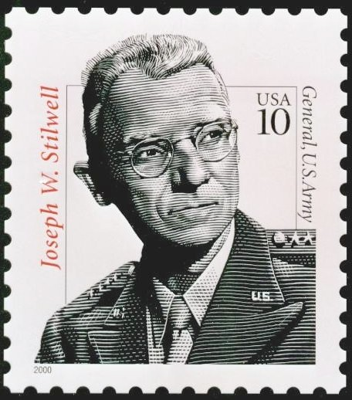







Cashier's algorithm for other denominations
Q. Is cashier's algorithm for any set of denominations?
A. No. Consider U.S. postage: 1, 10, 21, 34, 70, 100, 350, 1225, 1500.
・Cashier's algorithm: 140¢ = 100 + 34 + 1 + 1 + 1 + 1 + 1 + 1.
・Optimal: 140¢ = 70 + 70.
A. No. It may not even lead to a feasible solution if c1 > 1: 7, 8, 9.
・Cashier's algorithm: 15¢ = 9 + ???.
・Optimal: 15¢ = 7 + 8.

Slide 8
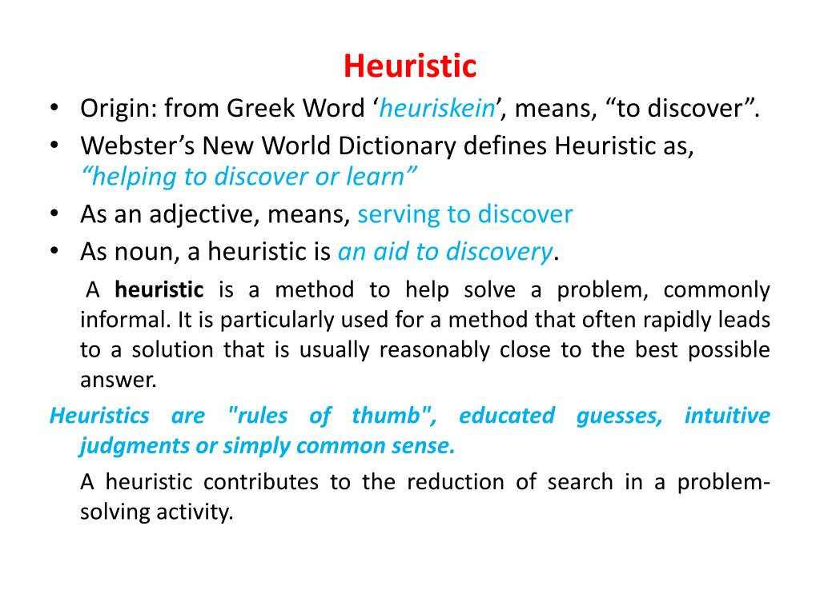

Slide 9

https://www.youtube.com/watch?v=I25LUoTWRVE

Slide 10
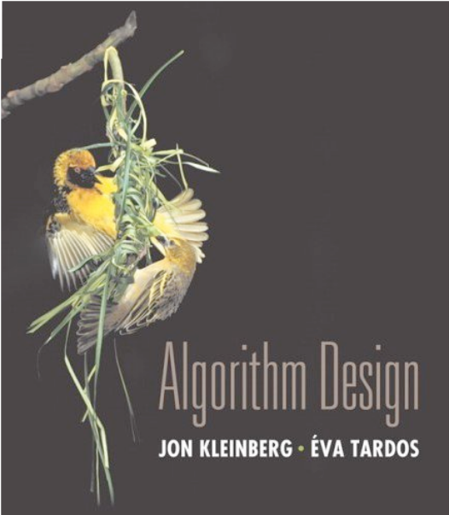

4. Greedy Algorithms I
coin changing
interval scheduling
scheduling to minimize lateness
optimal caching
Section 4.1

Slide 11
Interval scheduling
・Job j starts at s_{j} and finishes at f_{j}.
・Two jobs compatible if they don't overlap.
・Goal: find maximum subset of mutually compatible jobs.
a
b
b
c
d
jobs d and g are incompatible
e
e
f
g
h
h
time
0
1
2
3
4
5
6
7
8
9
10
11

Slide 12
Interval scheduling: greedy algorithms
Greedy template. Consider jobs in some natural order.
Take each job provided it's compatible with the ones already taken.
・[Earliest start time] Consider jobs in ascending order of s_{j}.
・[Earliest finish time] Consider jobs in ascending order of f_{j}.
・[Shortest interval] Consider jobs in ascending order of f_{j} – s_{j}.
・[Fewest conflicts] For each job j, count the number of conflicting jobs c_{j}. Schedule in ascending order of c_{j}.

Slide 13
Interval scheduling: greedy algorithms
Greedy template. Consider jobs in some natural order.
Take each job provided it's compatible with the ones already taken.
counterexample for earliest start time
counterexample for shortest interval
counterexample for fewest conflicts

Slide 14

Interval scheduling: earliest-finish-time-first algorithm
EARLIEST-FINISH-TIME-FIRST (n, s1, s2, …, sn , f1, f2, …, fn)
SORT jobs by finish time so that f1 ≤ f2 ≤ … ≤ fn
A ← φ
set of jobs selected
For j = 1 to n
IF job j is compatible with A A ← A ∪ { j }
Return A
Proposition. Can implement earliest-finish-time first in O(n log n) time.
・Keep track of job j* that was added last to A.
・Job j is compatible with A iff s_{j} ≥ f_{j*} .
・Sorting by finish time takes O(n log n) time.

Slide 15
Interval scheduling: analysis of earliest-finish-time-first algorithm
Theorem. The earliest-finish-time-first algorithm is optimal. Pf. [by contradiction]
・Assume greedy is not optimal, and let's see what happens.
・Let i₁, i₂, ... i_{k} denote set of jobs selected by greedy.
・
Let j₁, j₂, ... j_{m} denote set of jobs in an optimal solution with
i₁ = j₁, i₂ = j₂, ..., i_{r} = j_{r} for the largest possible value of r.
job i_{r+1} exists and finishes before j_{r+1}
Greedy:
i₁
i₂
i_{r}
^{i}r+1
. . .
i_{k}
j₁
j₂
j_{r}
^{j}r+1
. . .
j_{m}
OPT:
why not replace job j_{r+1} with job i_{r+1}?

Slide 16
Interval partitioning
Interval partitioning.
・Lecture j starts at s_{j} and finishes at f_{j}.
・Goal: find minimum number of classrooms to schedule all lectures so that no two lectures occur at the same time in the same room.
Ex. This schedule uses 4 classrooms to schedule 10 lectures.
 |  |  |  |  |  |  | e |  |  |  |  | j
 | c |  |  |  | d |  |  |  | g
 |  |  | b |  |  |  |  |  |  |  | h
 | a |  |  |  |  |  |  |  | f |  |  | i
4
3
2
1
9
9:30
10
10:30
11
11:30
12
12:30
1
1:30
2
2:30
3
3:30
4
4:30
time

Slide 17
Interval partitioning
Interval partitioning.
・Lecture j starts at s_{j} and finishes at f_{j}.
・Goal: find minimum number of classrooms to schedule all lectures so that no two lectures occur at the same time in the same room.
Ex. This schedule uses 3 classrooms to schedule 10 lectures.
 | c |  |  |  | d |  |  |  | f |  |  |  | j
 |  |  | b |  |  |  |  |  | g |  |  |  | i
 | a |  |  |  |  |  | e |  |  |  |  | h
3
2
1
9
9:30
10
10:30
11
11:30
12
12:30
1
1:30
2
2:30
3
3:30
4
4:30
time

Slide 18
Interval partitioning: greedy algorithms
Greedy template. Consider lectures in some natural order. Assign each lecture to an available classroom (which one?); allocate a new classroom if none are available.
・[Earliest start time] Consider lectures in ascending order of s_{j}.
・[Earliest finish time] Consider lectures in ascending order of f_{j}.
・[Shortest interval] Consider lectures in ascending order of f_{j} – s_{j}.
・[Fewest conflicts] For each lecture j, count the number of conflicting lectures c_{j}. Schedule in ascending order of c_{j}.

Slide 19
Interval partitioning: greedy algorithms
Greedy template. Consider lectures in some natural order. Assign each lecture to an available classroom (which one?); allocate a new classroom if none are available.
counterexample for earliest finish time
3
2
1
counterexample for shortest interval
3
2
1
counterexample for fewest conflicts
3
2
1

Slide 20
Interval partitioning: earliest-start-time-first algorithm
EARLIEST-START-TIME-FIRST (n, s1, s2, …, sn , f1, f2, …, fn)
SORT lectures by start time so that s1 ≤ s2 ≤ … ≤ sn.
d ← 0
number of allocated classrooms
For j = 1 to n
IF lecture j is compatible with some classroom Schedule lecture j in any such classroom k.
Else
Allocate a new classroom d + 1. Schedule lecture j in classroom d + 1. d ← d + 1
RETURN schedule.

Slide 21
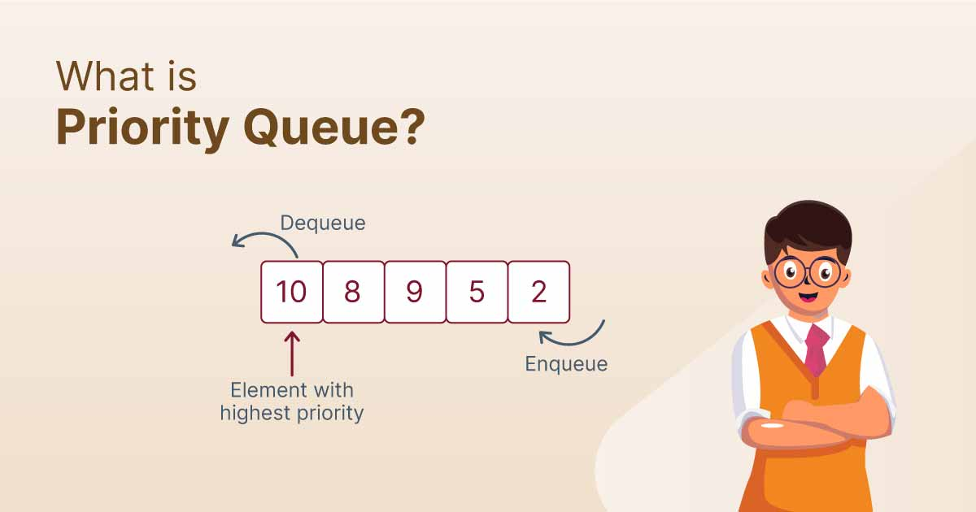
Interval partitioning: earliest-start-time-first algorithm
Proposition. The earliest-start-time-first algorithm can be implemented in
O(n log n) time.
Pf. Store classrooms in a priority queue (key = finish time of its last lecture).
・To determine whether lecture j is compatible with some classroom, compare sj to key of min classroom k in priority queue.
・To add lecture j to classroom k, increase key of classroom k to fj.
・Total number of priority queue operations is O(n). https://www.youtube.com/watch?v=pLIajuc31qk
・Sorting by start time takes O(n log n) time. ▪
Remark. This implementation chooses the classroom k whose finish time of its last lecture is the earliest.

Slide 22
Interval partitioning: lower bound on optimal solution
Def. The depth of a set of open intervals is the maximum number that contain any given time.
“Suppose at some moment three lectures are happening at the same time. Can I fit them into two classrooms?”🙋
Key observation. Number of classrooms needed ≥ depth.
Q. Does number of classrooms needed always equal depth?
A. Yes! Moreover, earliest-start-time-first algorithm finds one.
depth = 3
3
c
d
f
j
2
b
g
i
1
a
e
h
9 9:30
10 10:30
11 11:30 12 12:30
1 1:30 2
2:30
3 3:30 4
4:30
time

Slide 23
Interval partitioning: analysis of earliest-start-time-first algorithm
Observation. The earliest-start-time first algorithm never schedules two incompatible lectures in the same classroom.
Theorem. Earliest-start-time-first algorithm is optimal. Pf.
・Let d = number of classrooms that the algorithm allocates.
・Classroom d is opened because we needed to schedule a lecture, say j, that is incompatible with all d – 1 other classrooms.
・These d lectures each end after s_{j}.
・Since we sorted by start time, all these incompatibilities are caused by lectures that start no later than s_{j}.
・Thus, we have d lectures overlapping at time s_{j} + ε.
・Key observation ⇒ all schedules use ≥ d classrooms.
https://www.youtube.com/watch?v=OxGsU8oIWjY▪ (ignore)

Slide 24
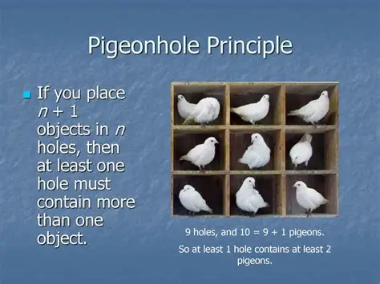

Slide 25

Hilbert’s Hotel Paradox
网络视频
https://www.youtube.com/watch?v=Uj3_KqkI9Zo&pp=ygUPaGlsYmVydCdzIGhvdGVs
温馨提示：此视频框在点击“上传手机课件”时会进行转换，用手机进行观看时则会变为可点击的视频。此视频框可被拖动移位和修改大小。

Slide 26

https://www.youtube.com/watch?v=Uj3_KqkI9Zo&pp=ygUPaGlsYmVydCdzIGhvdGVs

Slide 27
4. Greedy Algorithms I
coin changing
interval scheduling
scheduling to minimize lateness
optimal caching
Section 4.2

Slide 28
Scheduling to minimizing lateness
Minimizing lateness problem.
・Single resource processes one job at a time.
・Job j requires t_{j} units of processing time and is due at time d_{j}.
・If j starts at time s_{j}, it finishes at time f_{j} = s_{j} + t_{j}.
・Lateness: ℓ_{j} = max { 0, f_{j} – d_{j} }.
・Goal: schedule all jobs to minimize maximum lateness L = max_{j} ℓ_{j}.
 | 1 | 2 | 3 | 4 | 5 | 6
t_{j} | 3 | 2 | 1 | 4 | 3 | 2
d_{j} | 6 | 8 | 9 | 9 | 14 | 15
lateness = 2
lateness = 0
max lateness = 6
d₃ = 9 | d₂ = 8 | d₆ = 15 | d₁ = 6 | d₅ = 14 | d₄ = 9
0
1
2
3
4
5
6
7
8
9
10
11
12
13
14
15

Slide 29
Minimizing lateness: greedy algorithms
Greedy template. Schedule jobs according to some natural order.
・[Shortest processing time first] Schedule jobs in ascending order of processing time t_{j}.
・[Earliest deadline first] Schedule jobs in ascending order of deadline d_{j}.
・[Smallest slack] Schedule jobs in ascending order of slack d_{j} – t_{j}.

Slide 30
Minimizing lateness: greedy algorithms
Greedy template. Schedule jobs according to some natural order.
・[Shortest processing time first] Schedule jobs in ascending order of processing time t_{j}.
 | 1 | 2
tj | 1 | 10
dj | 100 | 10
counterexample
・[Smallest slack] Schedule jobs in ascending order of slack d_{j} – t_{j}.
 | 1 | 2
tj | 1 | 10
dj | 2 | 10
counterexample

Slide 31
Minimizing lateness: earliest deadline first
EARLIEST-DEADLINE-FIRST (n, t1, t2, …, tn , d1, d2, …, dn)
SORT n jobs so that d1 ≤ d2 ≤ … ≤ dn. t ← 0
For j = 1 to n
Assign job j to interval [t, t +tj]. sj ← t ; fj ← t + tj
t ← t + tj
RETURN intervals [s1, f1], [s2, f2], …, [sn, fn].
max lateness = 1
d₁ = 6 | d₂ = 8 | d₃ = 9 | d₄ = 9 | d₅ = 14 | d₆ = 15
0
1
2
3
4
5
6
7
8
9
10
11
12
13
14
15

Slide 32
Minimizing lateness: no idle time
Observation 1. There exists an optimal schedule with no idle time.
d = 4 |  | d = 6 |  |  | d = 12
0
1
2
3
4
5
6
7
8
9
10
11
d = 4 | d = 6 | d = 12
0
1
2
3
4
5
6
7
8
9
10
11
Observation 2. The earliest-deadline-first schedule has no idle time.

Slide 33
Minimizing lateness: inversions
Def. Given a schedule S, an inversion is a pair of jobs i and j such that:
i < j but j scheduled before i.
inversion
f_{i}
 |  | j | i
[ as before, we assume jobs are numbered so that d₁ ≤ d₂ ≤ … ≤ d_{n} ]
Observation 3. The earliest-deadline-first schedule has no inversions.
Observation 4. If a schedule (with no idle time) has an inversion, it has one with a pair of inverted jobs scheduled consecutively.

Slide 34
Minimizing lateness: inversions
Def. Given a schedule S, an inversion is a pair of jobs i and j such that:
i < j but j scheduled before i.
inversion
f_{i}
before swap
 |  | j | i
after swap
 |  | i | j
f '_{j}
Claim. Swapping two adjacent, inverted jobs reduces the number of inversions by one and does not increase the max lateness.
Pf. Letℓbe the lateness before the swap, and let ℓ' be it afterwards.
・ℓ'_{k} = ℓ_{k} for all k ≠ i, j.
・ℓ'_{i} ≤ ℓ_{i}.
・If job j is late, ℓ'_{j} = f 'j – dj
(definition)
= | fi – | dj | ( j now finishes at time fi )
≤ | fi – | di | (since i and j inverted)
≤ | ℓ_{i} . |  | (definition)

Slide 35
Minimizing lateness: analysis of earliest-deadline-first algorithm
Theorem. The earliest-deadline-first schedule S is optimal. Pf. [by contradiction]
Define S* to be an optimal schedule that has the fewest number of inversions, and let's see what happens.
・Can assume S* has no idle time.
・If S* has no inversions, then S = S*.
・If S* has an inversion, let i–j be an adjacent inversion.
・Swapping i and j
- does not increase the max lateness
- strictly decreases the number of inversions
・This contradicts definition of S* ▪

Slide 36
Greedy analysis strategies
Greedy algorithm stays ahead. Show that after each step of the greedy algorithm, its solution is at least as good as any other algorithm's.
Structural. Discover a simple "structural" bound asserting that every possible solution must have a certain value. Then show that your algorithm always achieves this bound.
Exchange argument. Gradually transform any solution to the one found by the greedy algorithm without hurting its quality. (previous algorithm)
Other greedy algorithms. Gale-Shapley, Kruskal, Prim, Dijkstra, Huffman, …

Slide 37
What is Greedy Algorithm?
网络视频
https://www.youtube.com/watch?v=ilYwrsP7zzk&t=131s
温馨提示：此视频框在点击“上传手机课件”时会进行转换，用手机进行观看时则会变为可点击的视频。此视频框可被拖动移位和修改大小。

Slide 38
4. Greedy Algorithms I
coin changing
interval scheduling
scheduling to minimize lateness
optimal caching
Section 4.3

Slide 39
Optimal offline caching (Here)
Caching.
・Cache with capacity to store k items.
・Sequence of m item requests d₁, d₂, …, d_{m}.
・Cache hit: item already in cache when requested.
・Cache miss: item not already in cache when requested: must bring requested item into cache, and evict some existing item, if full.
Goal. Eviction schedule that minimizes number of evictions.
cache miss (eviction)
Ex. k = 2, initial cache = ab, requests: a, b, c, b, c, a, a. Optimal eviction schedule. 2 evictions.
a | a | b
b | a | b
c | c | b
b | c | b
c | c | b
a | a | b
b | a | b
requests
cache
34

Slide 40
Optimal offline caching: greedy algorithms
LIFO / FIFO. Evict element brought in most (east) recently. LRU. Evict element whose most recent access was earliest. LFU. Evict element that was least frequently requested.
previous queries
⋮
a | a | w | x | y | z
d | a | w | x | d | z
a | a | w | x | d | z
b | a | b | x | d | z
c | a | b | c | d | z
e | a | b | c | d | e
g
b
e
d
⋮
FIFO: eject a
LRU: eject d
current cache
LIFO: eject e
cache miss (which item to eject?)
future queries

Slide 41
Optimal offline caching: farthest-in-future (clairvoyant algorithm)
Farthest-in-future. Evict item in the cache that is not requested until farthest in the future.
current cache
cache miss (which item to eject?)
a | a | b | c | d | e
f
a
b
c
e
g
b
e
d
⋮
FF: eject d
future queries
Theorem. [Bélády 1966] FF is optimal eviction schedule. Pf. Algorithm and theorem are intuitive; proof is subtle.

Slide 42
Reduced eviction schedules
Def. A reduced schedule is a schedule that only inserts an item into the cache in a step in which that item is requested.
item inserted when not requested
a | a | b | c
a | a | x | c
c | a | d | c
d | a | d | b
a | a | c | b
b | a | x | b
c | a | c | b
a | a | b | c
a | a | b | c
a | a | b | c
a | a | b | c
c | a | b | c
d | a | d | c
a | a | d | c
b | a | d | b
c | a | c | b
a | a | b | c
a | a | b | c
an unreduced schedule
a reduced schedule

Slide 43
Reduced eviction schedules
Claim. Given any unreduced schedule S, can transform it into a reduced schedule S' with no more evictions.
Pf. [by induction on number of unreduced items]
・Suppose S brings d into the cache at time t, without a request.
・Let c be the item S evicts when it brings d into the cache.
・Case 1: d evicted at time t', before next request for d.
unreduced schedule S
Case 1
S'
 | . | . | c
 | . | . | c
 | . | . | c
¬d | . | . | d
 | . | . | d
 | . | . | d
e | . | . | e
 | . | . | e
 | . | . | c
 | . | . | c
 | . | . | c
¬d | . | . | c
 | . | . | c
 | . | . | c
e | . | . | e
 | . | . | e
time t
d enters cache without a request
might as well leave c in cache
time t'
d evicted before next request

Slide 44
Reduced eviction schedules
Claim. Given any unreduced schedule S, can transform it into a reduced schedule S' with no more evictions.
Pf. [by induction on number of unreduced items]
・Suppose S brings d into the cache at time t, without a request.
・Let c be the item S evicts when it brings d into the cache.
・Case 1: d evicted at time t', before next request for d.
・Case 2: d requested at time t' before d is evicted. ▪
unreduced schedule S
Case 2
S'
 | . | . | c
 | . | . | c
 | . | . | c
¬d | . | . | d
 | . | . | d
 | . | . | d
d | . | . | d
 | . | . | d
 | . | . | c
 | . | . | c
 | . | . | c
¬d | . | . | c
 | . | . | c
 | . | . | c
d | . | . | d
 | . | . | d
time t
d enters cache without a request
might as well leave c in cache
until d is requested
time t'
d requested before d evicted

Slide 45
Farthest-in-future: analysis
Theorem. FF is optimal eviction algorithm. Pf. Follows directly from invariant.
Invariant. There exists an optimal reduced schedule S that makes the same eviction schedule as S_{FF} through the first j requests.
Pf. [by induction on j]
Let S be reduced schedule that satisfies invariant through j requests. We produce S' that satisfies invariant after j + 1 requests.
・Consider (j + 1)^{st} request d = d_{j+1}.
・Since S and S_{FF} have agreed up until now, they have the same cache
・Case 1: (d is already in the cache). S' = S satisfies invariant.
contents before request j + 1.
・Case 2: (d is not in the cache and S and S_{FF} evict the same element).
S' = S satisfies invariant.

Slide 46
Farthest-in-future: analysis
Pf. [continued]
・Case 3: (d is not in the cache; S_{FF} evicts e; S evicts f ≠ e).
- begin construction of S' from S by evicting e instead of f
same | e | f
j
same | e | f
S
S'
same | e | d
j+1
same | d | f
now S' agrees with S_{FF} on first j + 1 requests; we show that having element f in cache is no worse than having element e
let S' behave the same as S until S' is forced to take a different action (because either S evicts e; or because either e or f is requested)

Slide 47
Farthest-in-future: analysis
Let j' be the first time after j + 1 that S' must take a different action from S, and let g be item requested at time j'.
involves e or f (or both)
same
e
j'
same
f
S S'
・Case 3a: g = e.
Can't happen with FF since there must be a request for f before e.
・Case 3b: g = f.
Element f can't be in cache of S, so let e' be the element that S evicts.
if e' = e, S' accesses f from cache; now S and S' have same cache
if e' ≠ e, we make S' evict e' and brings e into the cache; now S and S' have the same cache
We let S' behave exactly like S for remaining requests.
S' is no longer reduced, but can be transformed into a reduced schedule that agrees with SFF through step j+1

Slide 48
Farthest-in-future: analysis
Let j' be the first time after j + 1 that S' must take a different action from S, and let g be item requested at time j'.
involves e or f (or both)
same
e
j'
same
f
S
S'
otherwise S' could have take the same action
・Case 3c: g ≠ e, f. S evicts e.
Make S' evict f .
same
g
j'
same
g
S S'
Now S and S' have the same cache.
(and we let S' behave exactly like S for the remaining requests) ▪

Slide 49
Caching perspective
Online vs. offline algorithms.
・Offline: full sequence of requests is known a priori.
・Online (reality): requests are not known in advance.
・Caching is among most fundamental online problems in CS.
LIFO. Evict page brought in most recently.
LRU. Evict page whose most recent access was earliest.
FIF with direction of time reversed!
Theorem. FF is optimal offline eviction algorithm.
・Provides basis for understanding and analyzing online algorithms.
・LRU is k-competitive. [Section 13.8]
・LIFO is arbitrarily bad.

Slide 50

https://www.youtube.com/watch?v=lfQvPHGtu6Q

